Slide 1
UNIT – IV
WIRELESS STANDARDS

Slide 2
Contents
Electromagnetic Spectrum: Spectrum Allocation, Radio Propagation Mechanism,
Characteristics of Wireless Channel,
Wireless LANs: Architectural Comparison, Characteristics, Access Control,
IEEE 802.11: Architecture, MAC Sub Layer, Addressing Mechanism, Physical Layer,
Bluetooth: Architecture, Layers,
IEEE 802.16/WiMax: Services, Architecture, Layers,
Differences between Bluetooth, IEEE 802.11 and IEEE 802.16.

Slide 3
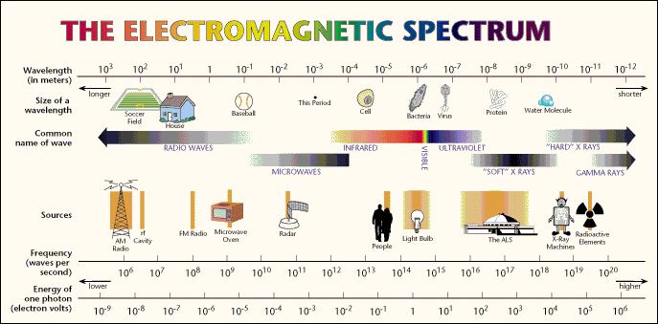


Slide 4
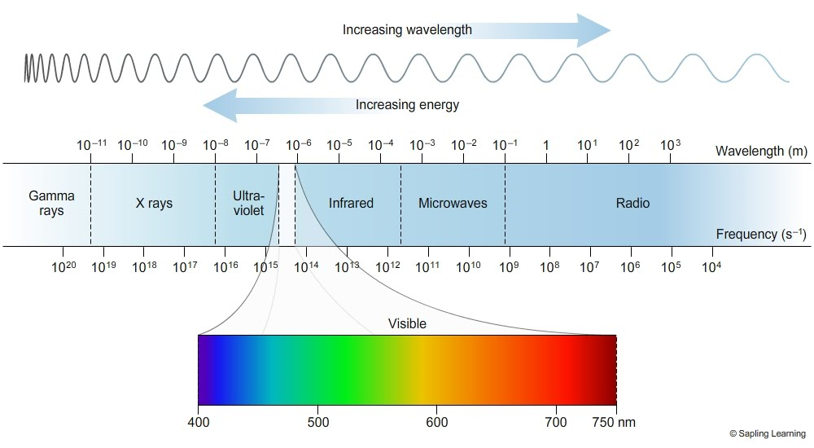

Slide 5
Chapter 2
Wireless LANs and PANs
Ref: Ad-Hoc Wireless Networks: Architecture and Protocols
By: C. Siva Ram Murthy and B. C. Manoj

Slide 6
2.1 Introduction
Fundamentals of WLANs
IEEE 802.11
HIPERLAN
Bluetooth
HomeRF

Slide 7
IEEE Standards
802.1 Interconnection (Bridging)
802.2 Logical Link Control
802.3 Ethernet (CSMA/CD) LAN
802.4 Token Bus LAN
802.5 Token Ring LAN
802.6 Metropolitan Area Networks
802.7 Broadband TAG
802.8 Fiber Optic TAG
802.9 Isochronous LAN
802.10 Security
802.11 Wireless LAN
802.12 Demand Priority
802.14 Cable Modem
802.15 Wireless Personal Area Network (PAN)
802.16 Broadband Wireless
802.17 Resilient Packet Ring
802.18 Radio Regulatory WG
802.19 Coexistence TAG
802.20 Mobile Broadband Wireless
802.21 Media Independent Handoff
802.22 Wireless Regional Area Networks

Slide 8
2.2 Fundamentals of WLANs
Difference between wireless and wired
  Address is not equivalent to physical location
  Dynamic topology and restricted connectivity
  Medium boundaries are not well-defined
  Error-prone medium

Slide 9
Use of WLANs
  Surf Internet on the move
  Areas without infrastructure, or affected by earthquakes or disasters → WLANs can be set up on the fly
  Historic buildings may not be wiring

Slide 10
Design Goals
  Operational simplicity
  Power-efficient operation
  License-free operation
  Tolerance to interference
  Global usability
  Security
  Safety requirements
  Quality of service requirement
  Compatibility with other technologies and applications

Slide 11
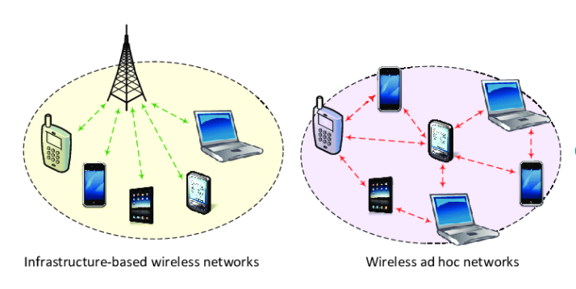
2.2.2 Network Architecture
Infrastructure Based vs. Ad Hoc LANs
  Infrastructure: access points (APs) and mobile stations (STAs)
  Ad hoc LANs: do not need fixed infrastructure

Slide 12
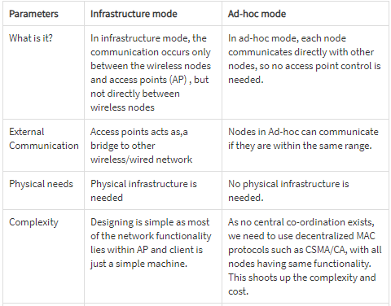

Slide 13
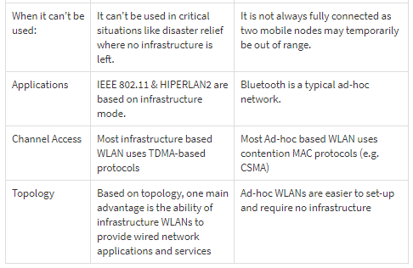

Slide 14
Network Architecture
Components in IEEE 802.11 network
  Basic Service Area: (BSA)
    The coverage area of an AP within which member stations (STAs or MTs) may remain in communication is called the basic service area.
  Basic Service Set: (BSS)
    The set of stations that can remain in contact (i.e., are associated) with a given AP is called a basic service set
  Distributed System: (DS)
    DS refers to an existing network infrastructure
  Extended Service Set:(ESS)
    The BSSs, DS, and the portals together with the stations they connect constitute the extended service set (ESS)

Slide 15
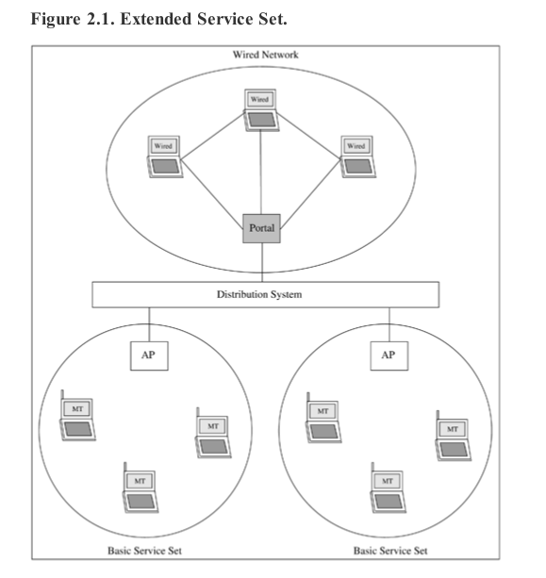

Slide 16
Service offered by IEEE 802.11 network
  Association
  Reassociation
  Diassociation
  Distribution: routing
  Integration: if send frames through non-802.11
  Authentication
  Deauthentication
  Privacy
  Data delivery

Slide 17
IEEE 802.11
Physical Layer
  Physical medium dependent sublayer (PMD)
    handles encoding, decoding, and modulation of signals
  Physical layer convergence protocol (PLCP)
    Abstracts functionality for MAC
    Offers service access point (SAP): 1 or 2Mbps
    Clear channel assessment (CCA): CSMA/CA
  3 choices:
    FHSS: GFSK and 4-level GFSK
    DSSS: DBPSK and DQPSK
    Infrared: PPM

Slide 18
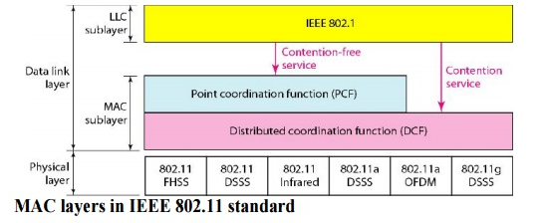
Basic MAC Layer Mechanisms
1

Slide 19
Basic MAC Layer Mechanisms
Distributed Foundation Wireless Medium Access Control (DFWMAC)
  Distributed coordination function (DCF)
  CSMA/CA
  To avoid hidden terminal, RTS/CTS
  Point coordination function (PCF): real time services
  Inter-Frame Spacing (IFS)
    SIFS ( Short Inter Frame Spacing)
    PIFS (PCF inter-frame spacing)
    DIFS (DCF inter-frame spacing)
    EIFS (Extended inter-frame spacing)

Slide 20
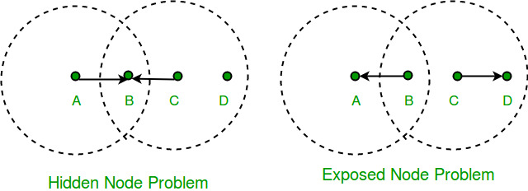
Hidden Station & Exposed Station Problem

Slide 21
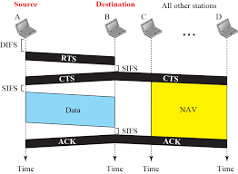
CSMA/CA and NAV Mechanism
CSMA/CD is not applicable

Slide 22
If medium is busy, node backs off, in which station defers channel access by a random time chosen within contention window (CW)
As backoff counter reaches zero, station can access medium
During backoff, if busy channel, freeze backoff counter; resume once channel becomes idle
CW size
  Unnecessary delay if too large
  Collision probability increase if too small
  Binary exponential backoff technique is used

Slide 23
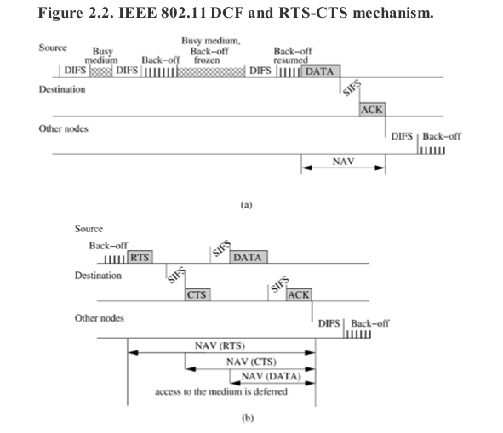
本圖取自"Ad Hoc Wireless Networks", by C. Siva Ram Murthy and B. S. Manoj, published by Prentice Hall, 2004

Slide 24
Overhead involved in RTS-CTS
Non-negligible overhead
If frame size > RTS_threshold, RTS-CTS is activated, a four-way handshake (I.e. RTS-CTS-DATA-ACK)
If frame size < RTS_threshold, a two-way handshake (DATA-ACK)

Slide 25
2.3.4 Other MAC Layer Functionalities
Point Coordination Function
  Guarantee on maximum access delay, minimum transmission bandwidth and other QoS
  Centralized scheme, applicable only in networks where AP (Point Coordinator) pool nodes
  Superframe: contention free periods(CFP)+contention period(CP)

Slide 26
Synchronization
Timing synchronization function (TSF)
Required for
  Power management
  PCF coordination
  Frequency hopping spread spectrum (FHSS) hopping sequence synchronization
Within a BSS
  Quasi periodic beacon frames transmitted by AP
  Contains time-stamp for adjusting clock
  Contains information for power optimization and roaming

Slide 27
Power Management
Always ready to receive consume more power (as high as 100 mA)
Transceiver must be switched off whenever carrier sensing is not needed
2 states: sleep and awake
  Longer periods in sleep leads to low throughput
  Shorter periods in sleep leads to high power consumption

Slide 28
Roaming
Provide uninterrupted service when walk around with a wireless station
When poor quality of current link, start scanning for another AP
  Active scanning: send a probe on each channel and wait for response
  Passive scanning: listen medium to find other networks

Slide 29
2.3.5 Other Issues
Newer standards
  802.11a/11b/g
  Trademark by Wireless Ethernet Compatibility Alliance (WECA) as Wi-Fi
  802.11e: time-sensitive applications, voice/video
  802.11f: inter-AP communication to handle roaming
  802.11i: advanced encryption for better privacy

Slide 30
QoS for Voice and Video Packets
Delay-sensitive packets: higher priority
  Hybrid coordination function (HCF): AP polls stations in a weighted way to offer QoS
  Extended DCF: higher priority stations choose random back-off interval from a smaller CW.

Slide 31
Wired Equivalent Privacy (WEP)
Data integrity
Access control
Confidentiality
Vulnerable if more sophisticated mechanisms are used to crack the key

Slide 32
2.5 Bluetooth
Consortium: Ericsson, Intel, IBM, Nokia, Toshiba - many members
Scenarios
  connection of peripheral devices
    loudspeaker, joystick, headset
  support of ad-hoc networking
    small devices, low-cost
  bridging of networks
    e.g., GSM via mobile phone - Bluetooth - laptop
Simple, cheap, replacement of IrDA, low range, lower data rates
  2.4 GHz, FHSS (CDMA), TDD

Slide 33
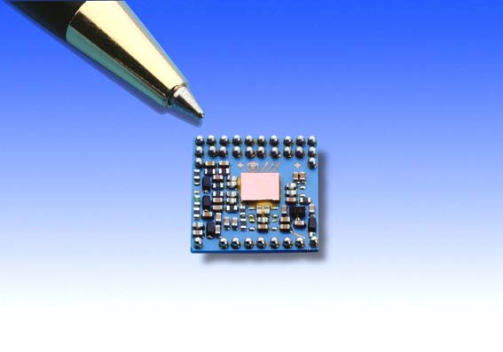
Technology Characteristics
Low-cost,
Low-power,
Small-sized,
Short-range,
Robust wireless technology

Slide 34
General Characteristics
Universal wireless interface
Ad-hoc networking architecture
80 Mhz in unlicenced ISM band at 2.45 Ghz
Gross bitrate 1 Mbps
Simultaneous voice and high speed data support
Evolves from cable replacement -> networking solution

Slide 35
Bluetooth
Logically partitioned into 3 layers:
  Transport protocol group
    Radio layer
    Baseband layer
    Link manager layer
    Logical link control
    Adaptation layer
    Host controller interface
  Middleware protocol group
    RFCOMM, SDP, IrDA
  Application group
    Application profiles

Slide 36
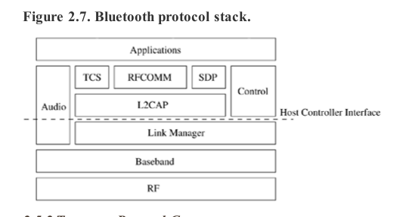
Fig 2.7 Bluetooth protocol stack

Slide 37
Radio (Physical) Layer
GFSK
64Kbps voice channels and asynchronous data channels with peak rate of 1Mbps
Data channel: asymmetric or symmetric
79 channels, 79 hops
Typical link range: up to 10 m, can be extended to 100m by increasing power

Slide 38
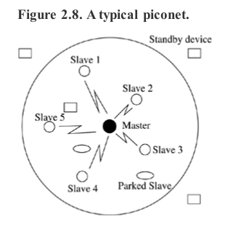
Baseband Layer
Piconet (Fig 2.8)
Each device has
address and clock
48-bit address
28 bit clock
本圖取自"Ad Hoc Wireless Networks", by C. Siva Ram Murthy and B. S. Manoj, published by Prentice Hall, 2004

Slide 39
Piconet
Master + up to 7 active slaves
For Identification, each active slave of the piconet is assigned a locally unique active member address AM_ADDR.
Other devices could be also in piconet in Parked mode
Device not associated with piconet is said to be in Standby mode

Slide 40
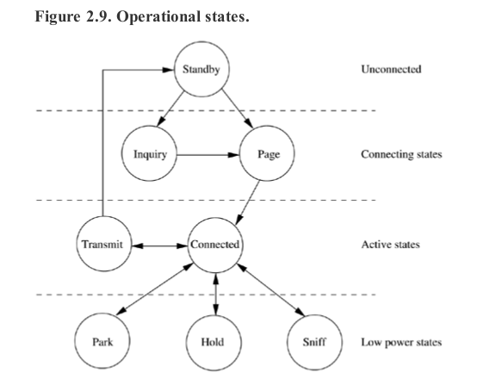
Fig 2.9 Operational States
本圖取自"Ad Hoc Wireless Networks", by C. Siva Ram Murthy and B. S. Manoj, published by Prentice Hall, 2004

Slide 41
States of a Bluetooth device
STANDBY
unconnected
inquiry
page
connecting
transmit
connected
active
PARK
HOLD
SNIFF
low power

Slide 42
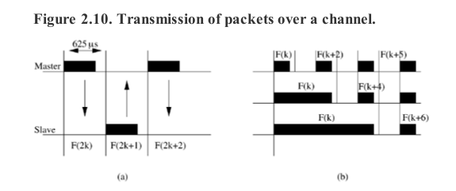
Fig 2.10 Transmission over a channel
ACL: asynchronous connectionless link
SCO: synchronous connection oriented link

Slide 43
Link Types
Synchronous Connection Oriented (SCO)
  Circuit switched typically used for voice
  Symmetric, synchronous service
  Slot reservation at fixed intervals
  Point-to-point
Asynchronous Connectionless Link (ACL)
  Packet switched
  Symmetric or asymmetric, asynchronous service
  Polling mechanism between master and slave(s)
  Point-to-point and point-to-multipoint

Slide 44
Flexibility: Multislot Packets
No frequency hopping during multislots, sequence continues after transmission
f_{n} f_{n+1} f_{n+2} f_{n+3} f_{n+4} f_{n+5}
Single slot
f_{n} f_{n+3}
Three slot
f_{n} f_{n+5}
Five slot

Slide 45
Inquiry State
A potential master sends inquiry packet on inquiry hop sequence of frequencies
A slave periodically enter inquiry scan state and listen for inquiry packets
When received, send response packet containing hopping sequence and device address

Slide 46
Page State
Master estimate slave’s clock to determine hop sequence, and send page message
Slaves listen in page scan mode
On receiving page message, slave enter page response sub-state, send page response containing its device access code (DAC)
Master enter page response state (after receiving slave’s response), inform slaves its clock and address for determining hopping sequence and synchronization

Slide 47
Scatternets and Issues
Piconet may overlap both spatially and temporally
Each piconet is characterized by a unique master and hop independently
As more piconets added, more probability of collisions
Device can participate in 2 or more piconets by time sharing (as a slave in several piconets, but as a master in only a single piconet)
A group of piconets →scatternet (Fig2.11)

Slide 48
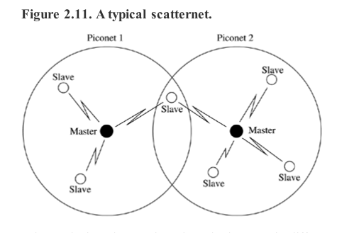
本圖取自"Ad Hoc Wireless Networks", by C. Siva Ram Murthy and B. S. Manoj, published by Prentice Hall, 2004

Slide 49
Issues:
  Gateway nodes: bound back-and-forth, hard to achieve full utilization
  Timing may miss:

Slide 50
Link Manager Protocol
Power Management
  Active mode: active slaves are polled by master
  Sniff mode: master issues a command to slave to enter sniff mode
  Hold mode: temporarily not support ACL packets, performing scanning, paging, inquiring, or attending another piconet
  Park mode: slave gives up its active member adress
Security Management
Minimal QoS support by allowing control over parameters such delay and jitter

Slide 51
2.5.4 Bluetooth Profiles
Promote interoperability among many implementations of bluetooth protocol stack
Provide a clear and transparent standard that can be used to implement a specific user end function
4 categories
  Generic profiles
  Telephony profiles
  Networking profiles
  Serial and object exchange profiles

